Slide 1

Customer Reviews Analysis
Reviews Data Source: airlinequality.com

Slide 2

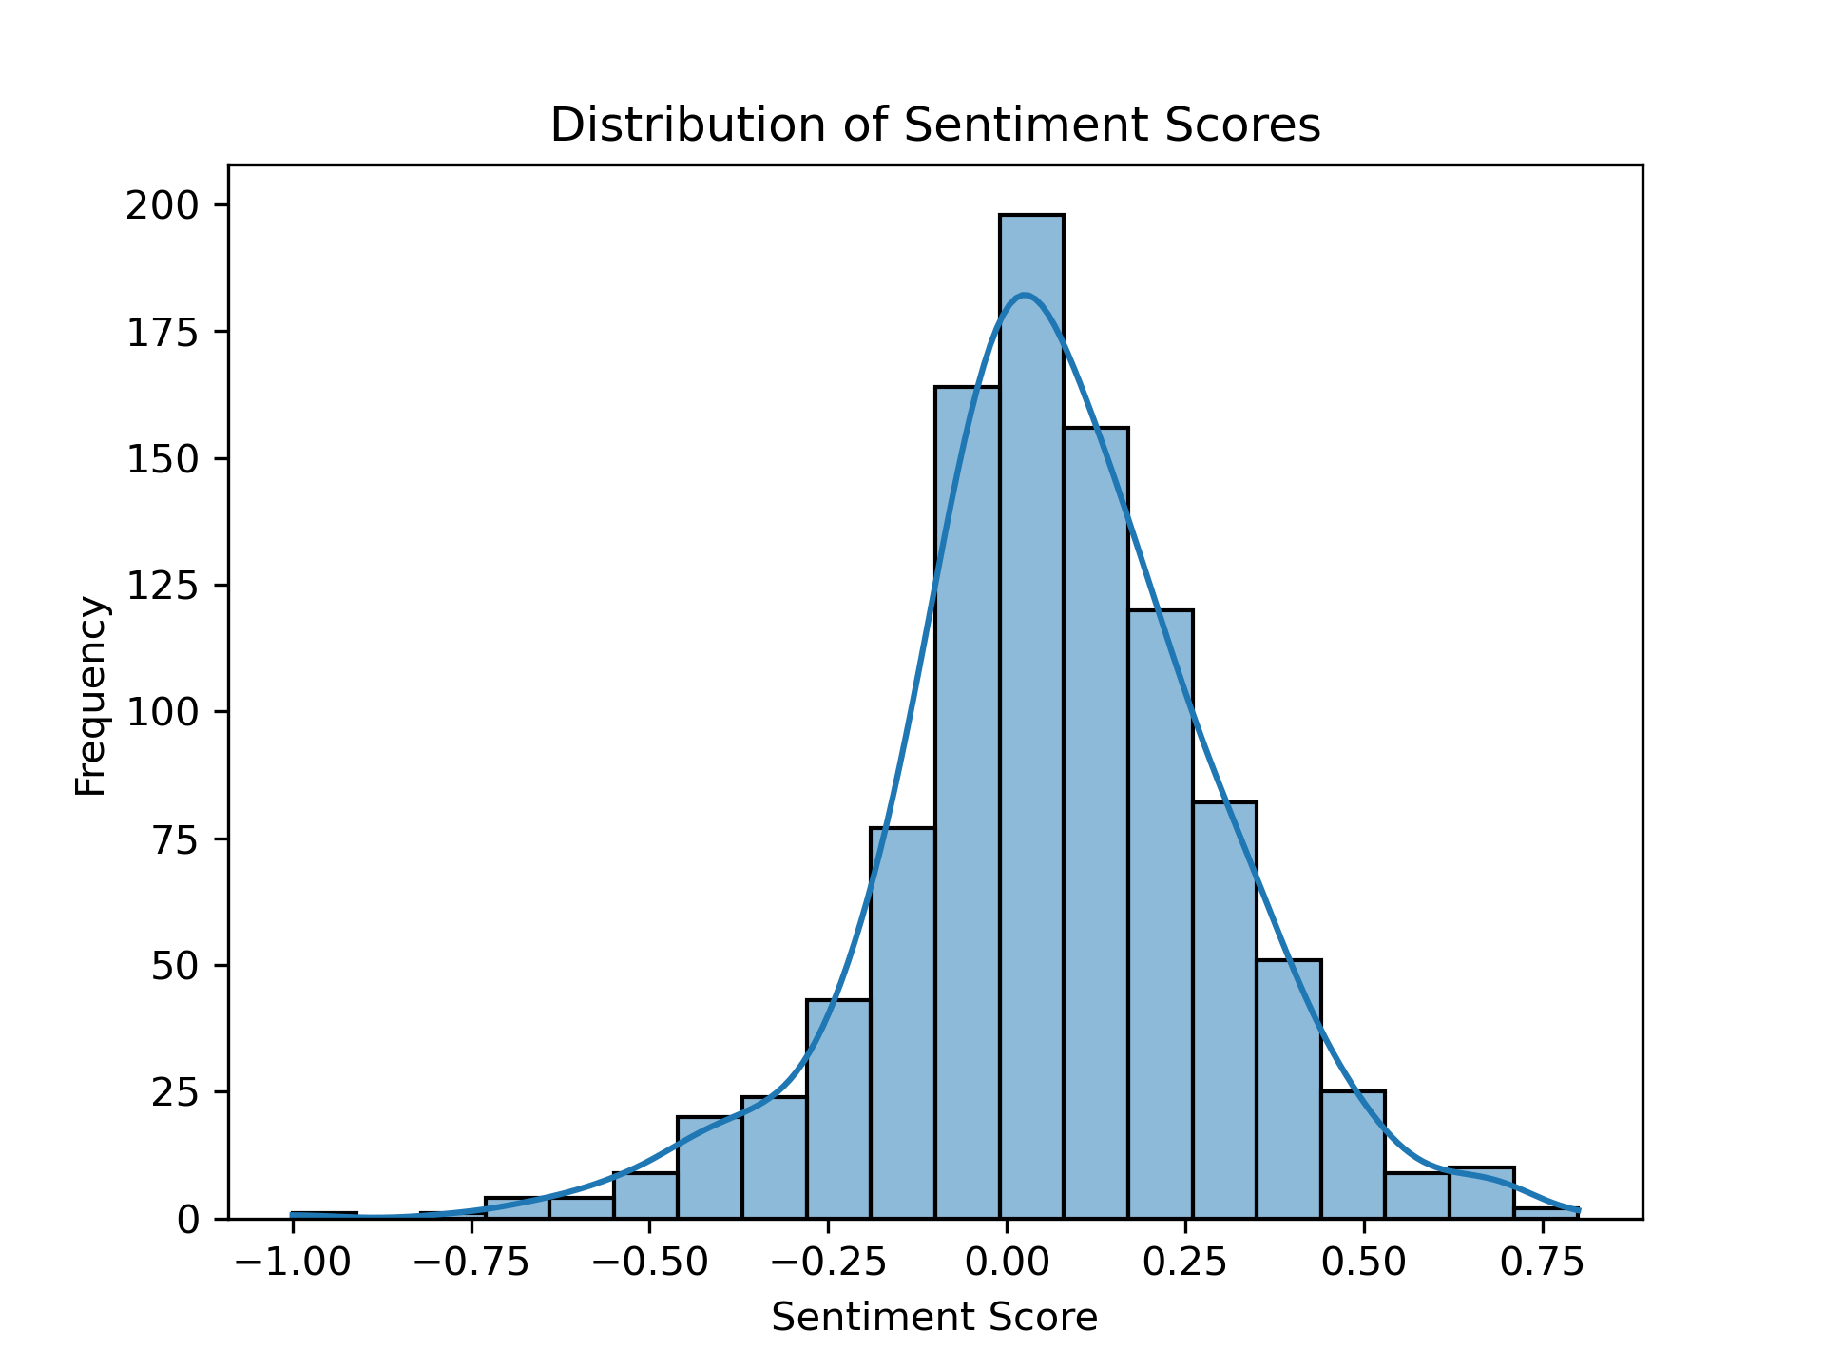
Customer Reviews Summary
62.5%
positive
1.4%
neutral
36.1%
negative
Insights:
The average sentiment analysis score of 0.064 shows that the customer’s sentiments towards British airways is inclined towards slightly positive but generally neutral.
The histogram shows that a greater proportion of customers have extremely negative opinions about the airline than exceptionally positive ones.
The solution can be found in word cloud. In it, the bigger the word size is, the more often it is mentioned in the reviews and hence it has higher impact on review polarity.
Improving the services related in those areas can greatly increase the customer satisfaction and consequently the British airway’s revenue.
Average Sentiment Score: 0.064

